Slide 1

Wireless Ground Vibration Sensor
Major Project

Slide 2
Table of contents
01
02
03
04
05
06
Problem Statement
Objective
Methodology
Hardware & Novelty
Work Done
Work Almost Done

Slide 3

01
Problem Statement

Slide 4
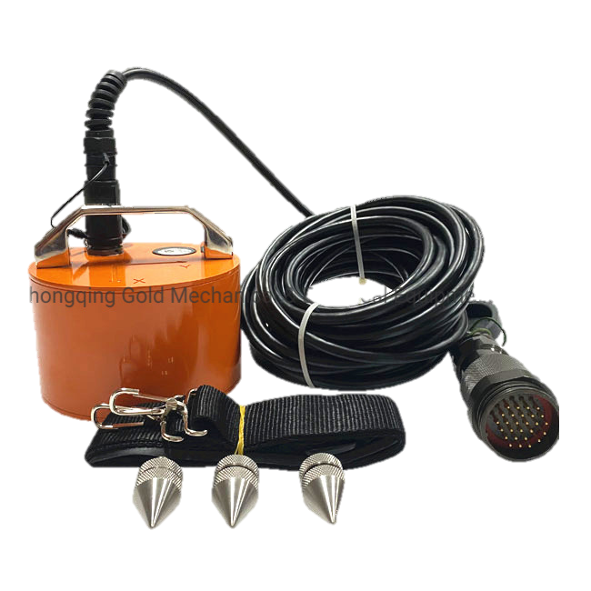
Existing Solutions
Wired
High Maintenance
Limited Scalability
High Operational Costs

Slide 5

02
Objective

Slide 6
Aim of the Project
Build upon the University of Kentucky's findings on ground vibration detection limitations and explore an alternative approach.
Instead of replacing sensor technology, our project introduces a wireless ground vibration sensor system using triaxial geophone sensors for accurate detection and improved data quality.
Key goals include wireless deployment, geophone integration, real-time monitoring, and cost efficiency.
This innovative solution aims to revolutionize ground vibration monitoring for diverse research and industrial applications, offering accuracy and cost-effectiveness.

Slide 7
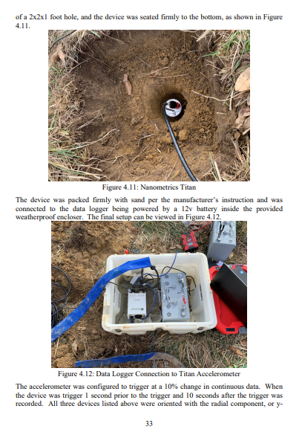

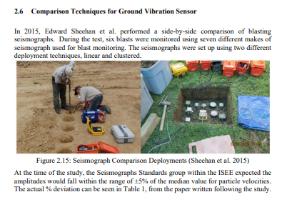
1. Enhancement of Previous Work 2. Application Diversification 3. Wireless Monitoring Implementation

Slide 8

03
Methodology

Slide 9
How we built our project
Sensing: Geophone Data
Conversion: 16-bit ADC
Reception: Esp32 Board
Transmission: EspNow Protocol
Wireless Reception: Esp32 Receiver
Data Processing: Received Data
Backend Upload: WebSocket Integration
Frontend Display: Webpage Visualization

Slide 10
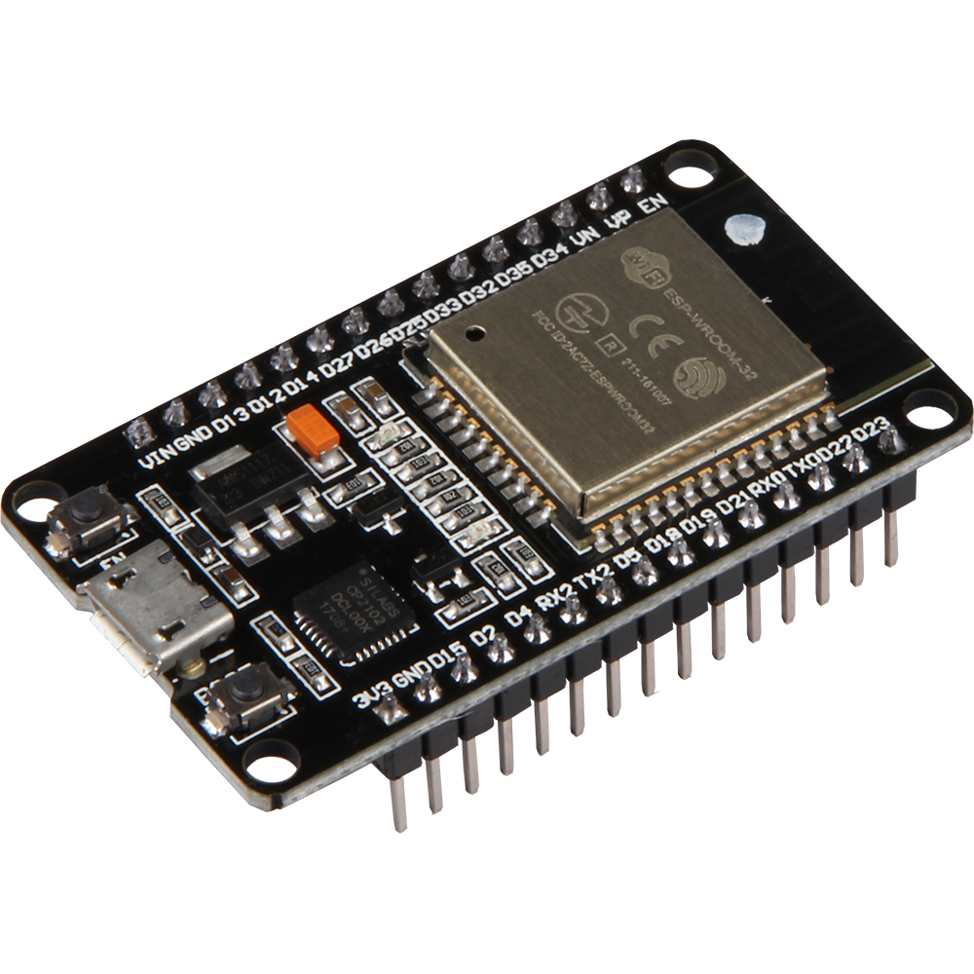
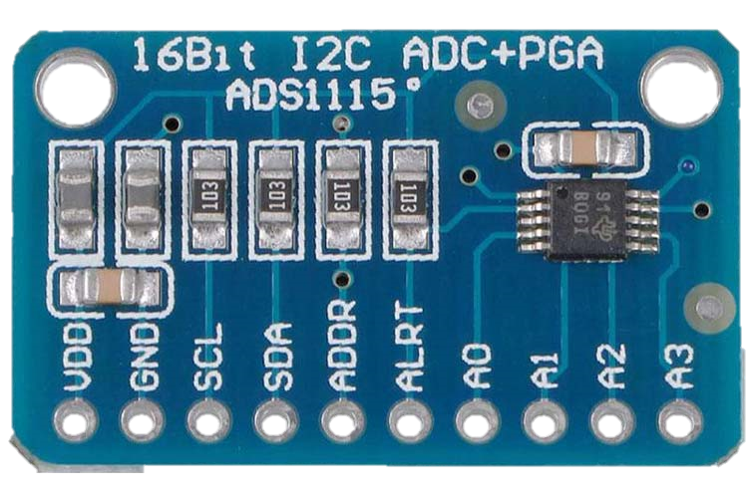

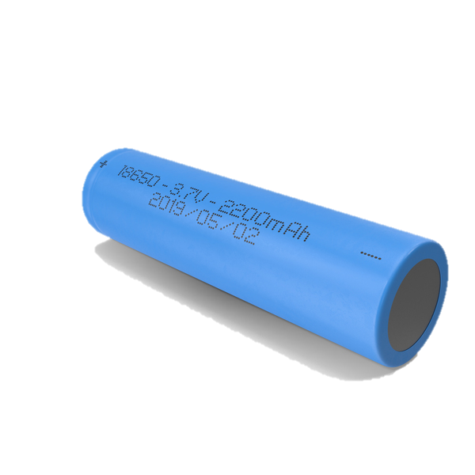
04
Hardware & Novelty

Slide 11
Components Used
Geophone Sensor
16-bit ADC
Utilized for precise detection of ground vibrations, the geophone sensor serves as the primary input device, capturing subtle movements with high sensitivity.
The 16-bit Analog-to-Digital Converter (ADC) ensures accurate and reliable conversion of geophone signals into digital data, preserving signal integrity for subsequent analysis.
Esp32 Board
18650 Battery
Acting as the brain of the system, the ESP32 microcontroller facilitates seamless integration of sensor data, wireless communication, and data processing, enabling efficient real-time monitoring and transmission of ground vibration data.
Powering the entire system, the 18650 battery provides a reliable and long-lasting energy source, ensuring continuous operation and data collection in various environmental conditions without the constraints of wired power sources.

Slide 12
Novelty
High-fidelity Wireless Data Transmission
Utilizing a 16-bit ADC and the ESPNow protocol ensures precise ground vibration measurements and efficient real-time data transmission, facilitating reliable monitoring in varied environments.
Portable and Autonomous Operation
The system's rechargeable 18650 battery enables portable deployment in remote or inaccessible areas, where traditional wired systems are impractical.
Web-based Data Visualization
The project's web-based interface enables intuitive data visualization and analysis, supporting decision-making across applications like structural health monitoring, environmental surveillance, and industrial maintenance.

Slide 13

05
Work Done

Slide 14
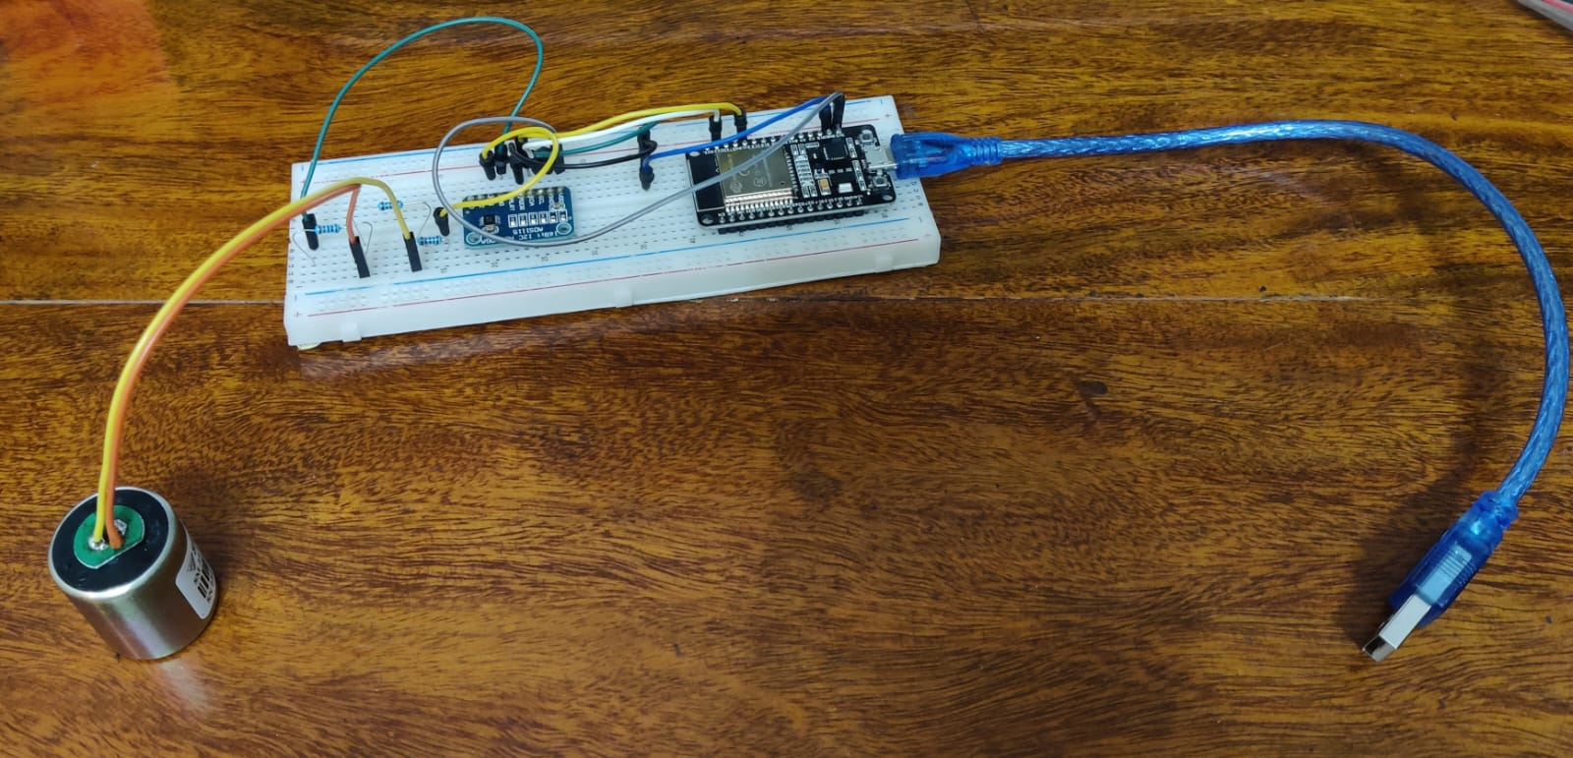
Final Circuit Integration
Circuit integration finalized, ensuring seamless functionality of the system.

Slide 15

GUI Frontend Development
Sleek and user-friendly GUI frontend developed for intuitive data interaction.

Slide 16
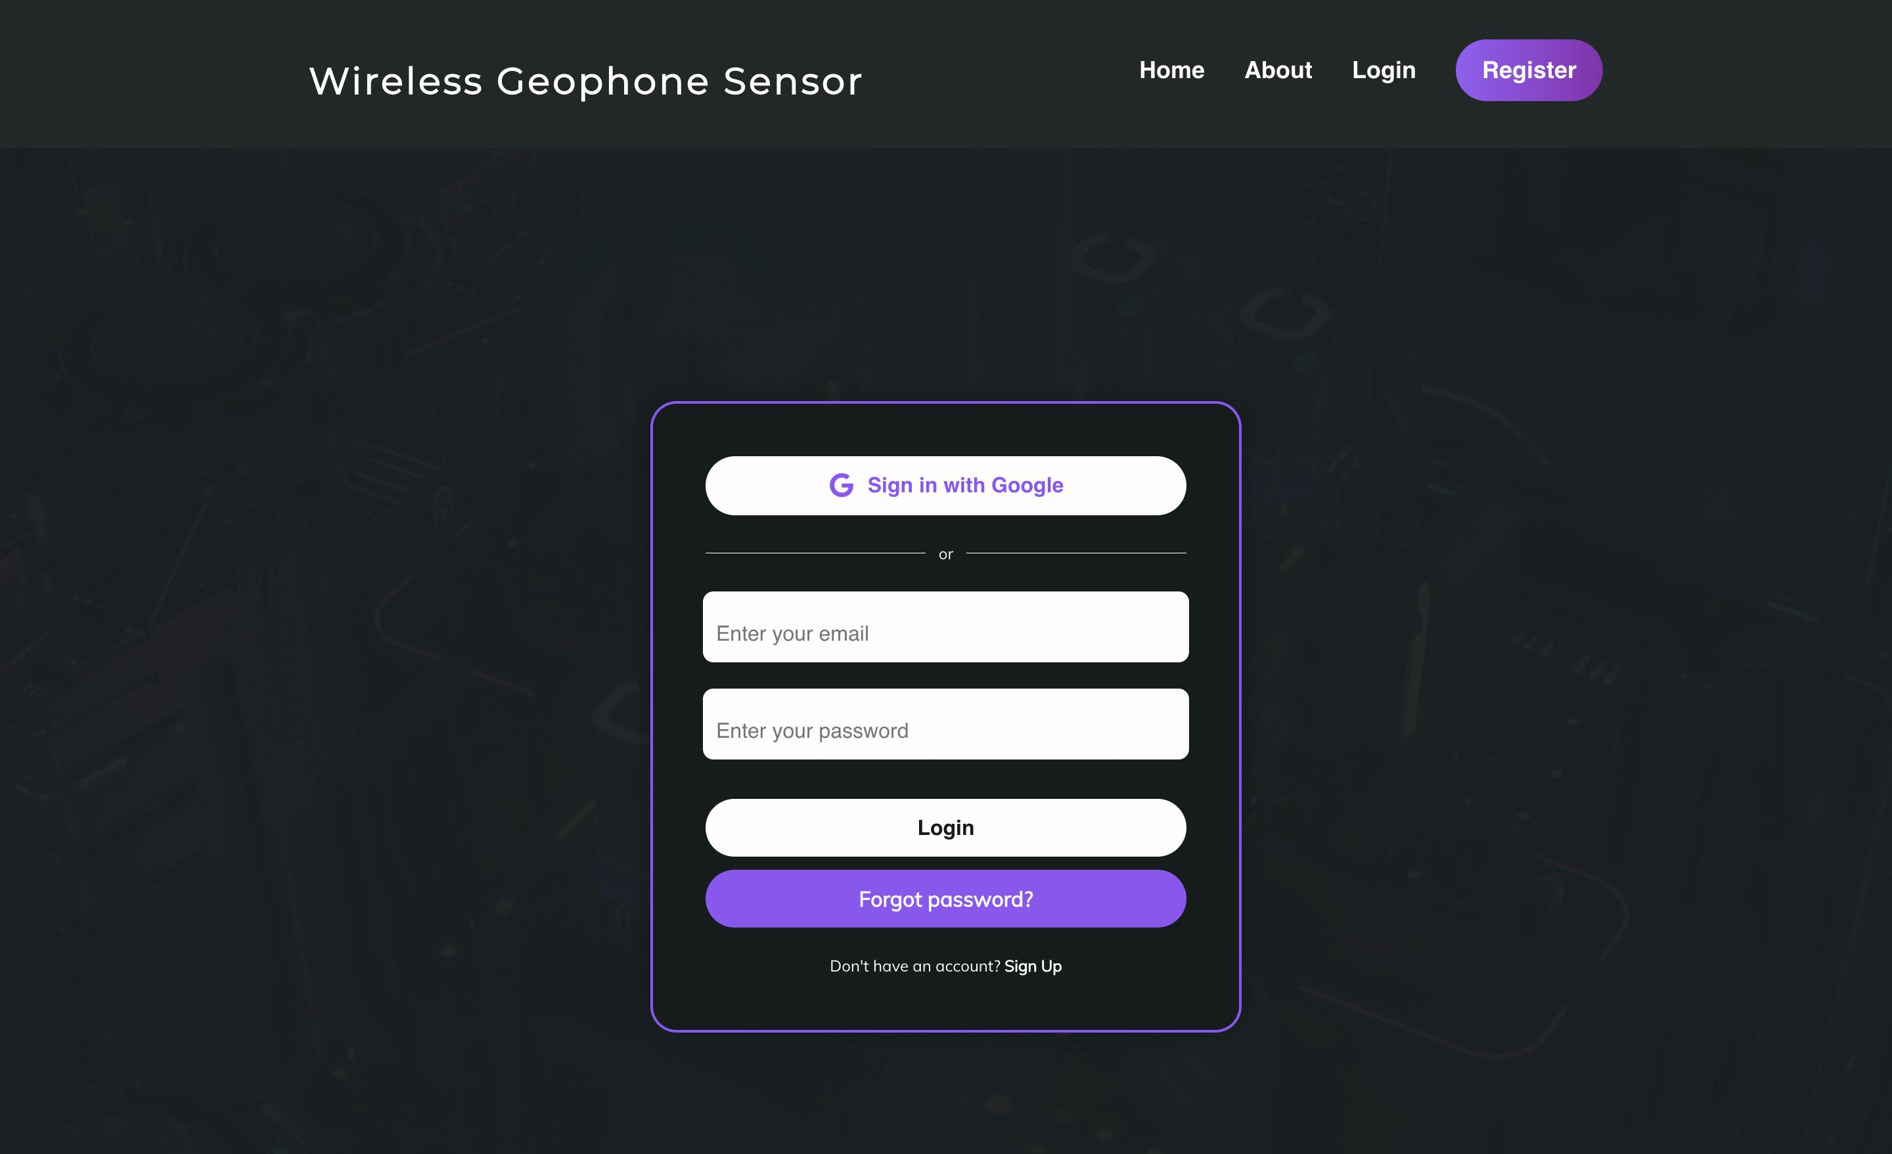
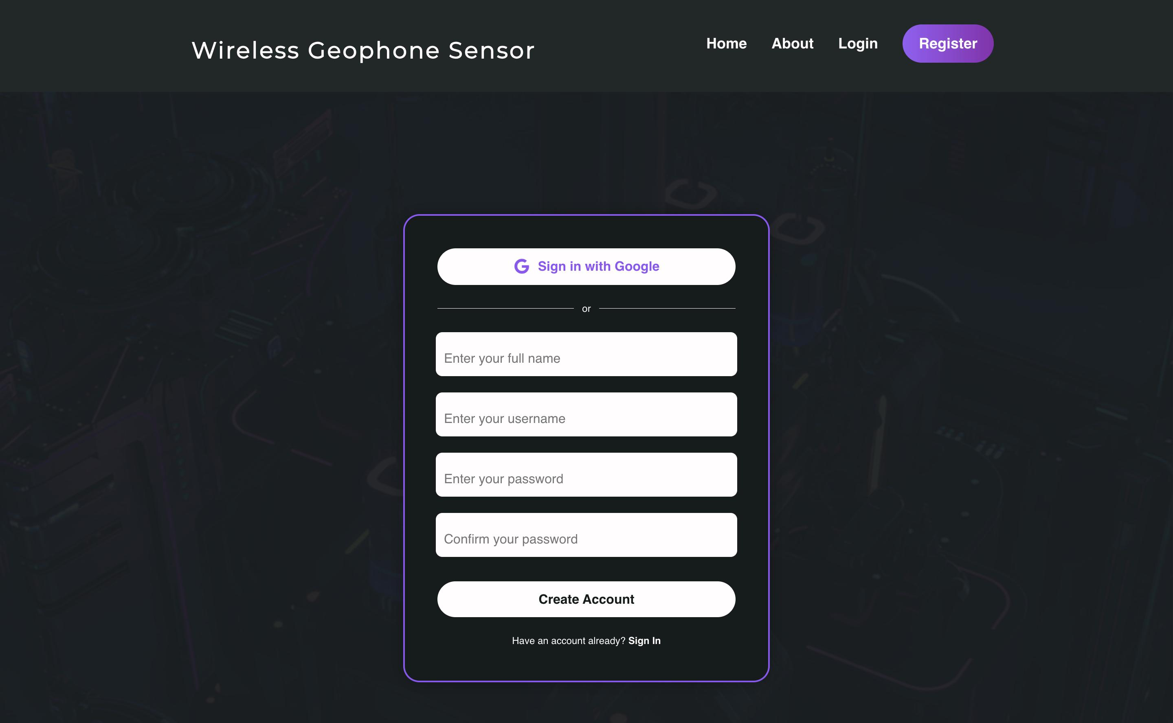

Slide 17
Parameter Calculation
Achieved successful wireless transmission of sensor data for real-time monitoring.
Precise parameter calculations conducted to enhance data accuracy and relevance.
Wireless Data Transmission

Slide 18
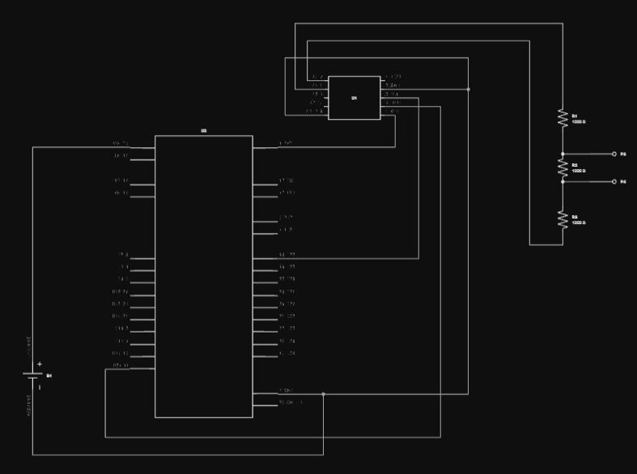
PCB Design and Fabrication Initiated
PCB meticulously designed and sent for fabrication to optimize system efficiency.

Slide 19
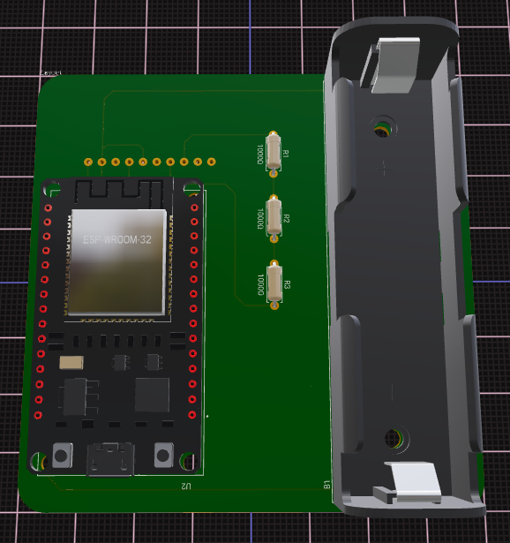
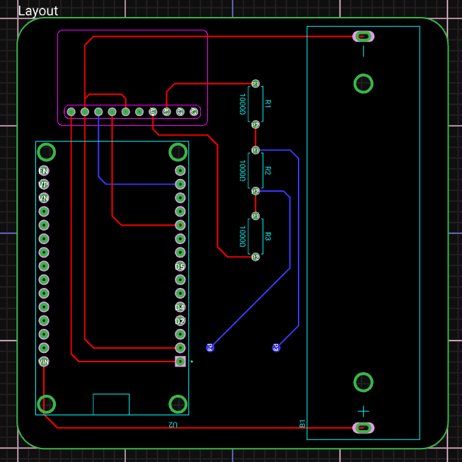

Slide 20
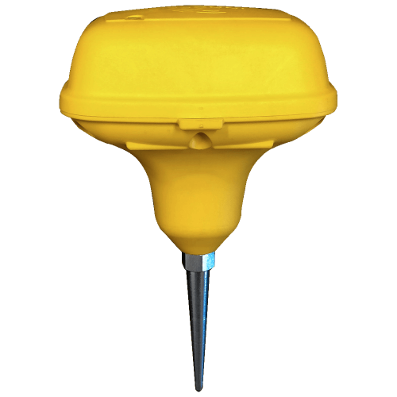
Advanced 3D Model Creation
Advanced 3D model crafted for comprehensive visualization of the sensor setup.

Slide 21

Efficient Backend Integration
Efficient backend integration is being achieved for seamless data management.

Slide 22

Our Team
Omkar Singh Sandhu 20105004
Akshat Kumar 20105005
Agrim Gupta 20105008
Rahul Sharma 20105015
Kanwar Ekamjot Singh 20105021
Thank You

